Slide 1
Land Based Investment Program
FFT started in 2005 after several years of no silviculture $$
LBIP was created in 2010 to consolidate a number of provincially funded land based programs (e.g. FIA, FFT) to ensure efficient and effective expenditures
LBIP now provides funding for 17 different categories of investment
2012/13 Budget was about $71 M
2013/14 Budget was cut to about $42 M, in order to balance the provincial budget
2014/15 DRAFT budget is back up to about $71 M, then increase by an extra $10 M for reforestation in 2015/16 +
Notes:
The Forests, Lands and Natural Resource Operations 2013/4 – 2015/16 Land Based Investment Strategy (LBIS) provides strategic guidance for land based investments and aligns the targets and outputs for eligible activities with government’s goals and objectives.
High level goals:
maximum productivity of forest resources
Sustainable development of forest resources
Coordinated, integrated and sustainable management, development and use of natural resources
Service Plan Goal of Timber Volume Gain in 65 years of about 8 M m3 per year

Slide 2
Investment Category | Sub Category | 2014/15 ($ M)
Forest For Tomorrow | Current reforestation | 32.23
 | Timber Supply Mitigation | 11.84
 | Forest health | 7.5
 | Invasive plants | 0.6
Tree Improvement |  | 3.0
Inventory | Site Prod., VRI | 7.5
 | EBM | 1.0
 | Visual | 0.2
Fire management |  | 0.18
Fish Passage |  | 2.5
Ecosystem Restoration |  | 1.0
Range |  | 0.84
Recreation |  | 0.75
Wildlife |  | 2.24
Total |  | 71.65
Notes:
DRAFT budget at this point, still subject to approval by Deputy Minister (Tim Sheldan)
Main point of this slide is to show the proportion of FFT program to total LBI budget
well over half.
Budgets and Annual Operating Plan
2104/15 Budget for FFT will be about $44 million ( 32 CR + 12 TSM), back to previous levels after severe reduction this fiscal ( about $26 million for CR only, no TSM)
An additional $10 Million will be available for “reforestation” in 2015/16 and beyond as per Ministers mandate letter from the premier or $54 million annually
AOP fine tuning will take place over the next few months and the next draft will be submitted in mid December.

Slide 3
LBIP Budget
2014/15
Notes:
Pie chart of budget table in previous slide.

Slide 4
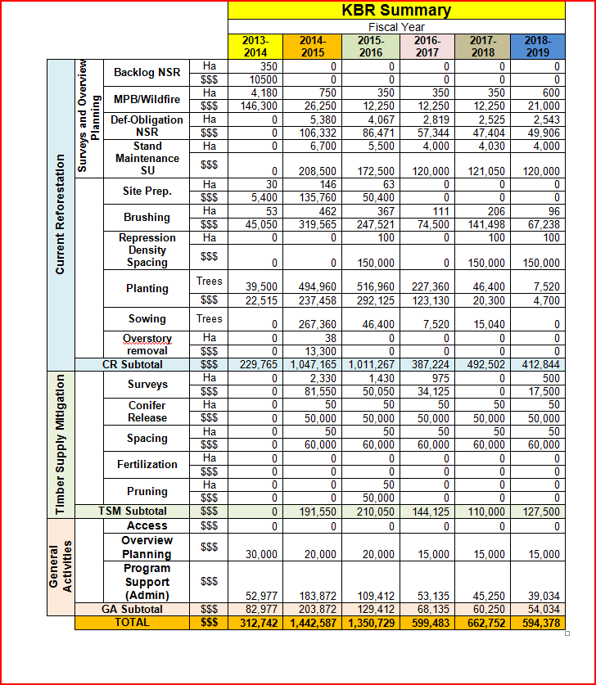

Slide 5
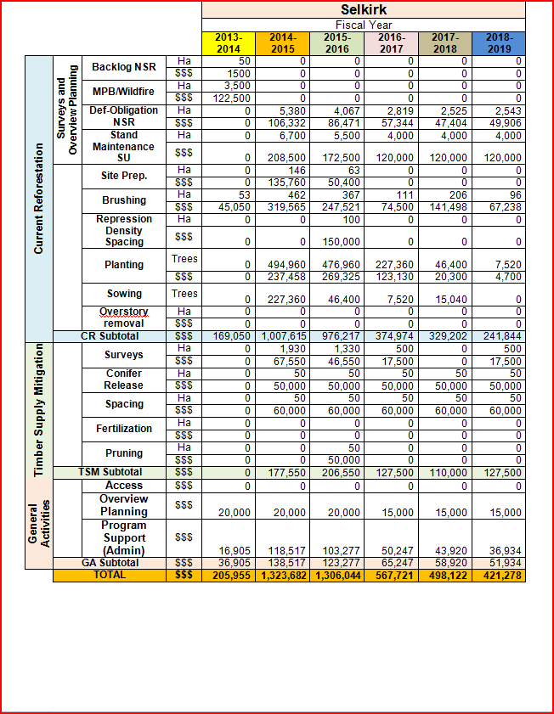

Slide 6
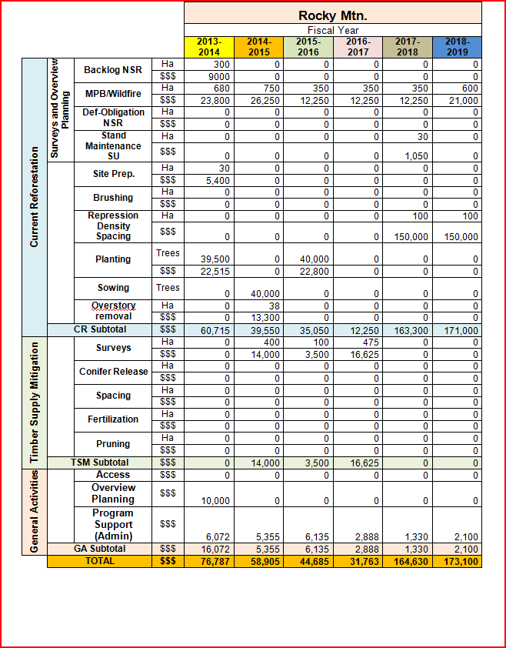

Slide 7
Type IV Silviculture Strategies
Scheduled for 3 TSA’s in KBR
Arrow, Cranbrook, Invermere TSA’s
Will produce a spatially explicit 5 year plan to guide silviculture investments
Expect licencee involvement
http://www.for.gov.bc.ca/hfp/silstrat/index.htm
Notes:
Priority TSA’s based on eligible TSA priority list for TSM investments
Similar to a TSR type analysis but with many more factors considered, eg climate change, wildlife habitat, wildfire management strategies
The multiple reasons for undertaking Type 4 SS include: (i) addressing mid-term timber supply;
(ii) assessing habitat supply;
(iii) responding to other issues such as hydrological impacts and fire risk; and
(iv) providing spatial tools that aid in the implementation of the SS.
The Type 4 SS help rationalize our funding requests to Treasury Board.
Type 4 SS is an on-going process (not just a plan) as assumptions need to be revised, and as new information is obtained or forest conditions change.

Slide 8
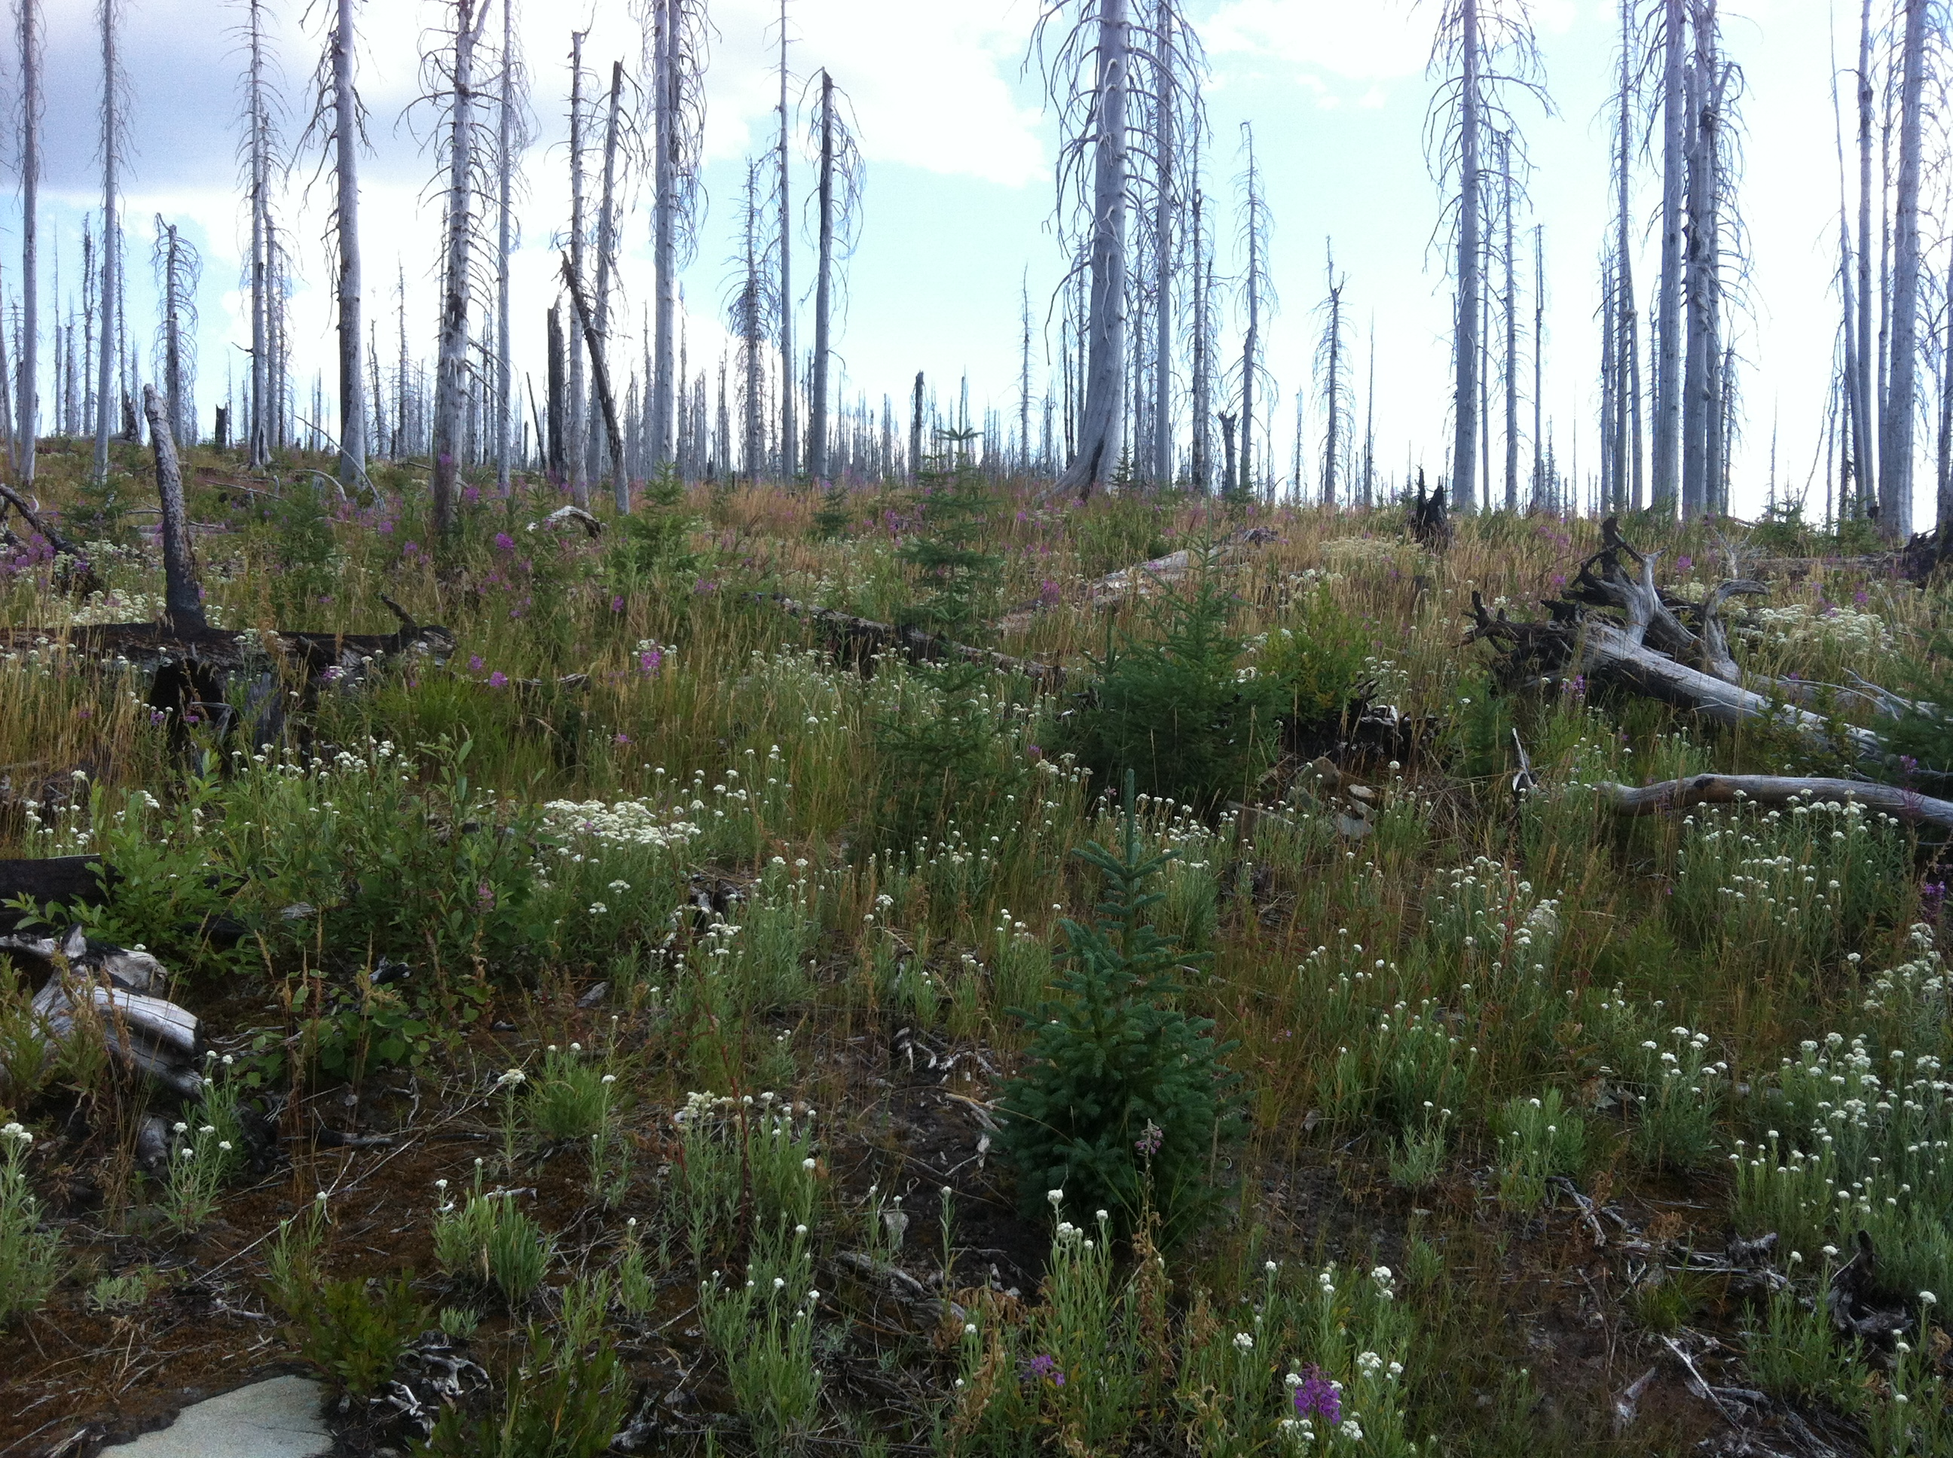
For more information:
http://www.for.gov.bc.ca/hcp/fia/landbase/
or
larry.hanlon@gov.bc.ca

